Slide 1

Stabilized-RED
Md. Zarif Ul Alam
1705010

Slide 2
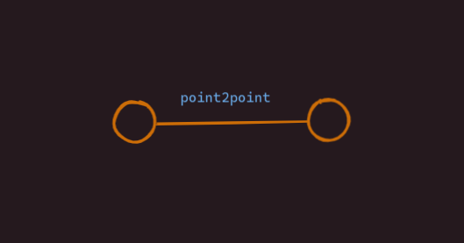
Building Topology

Slide 3
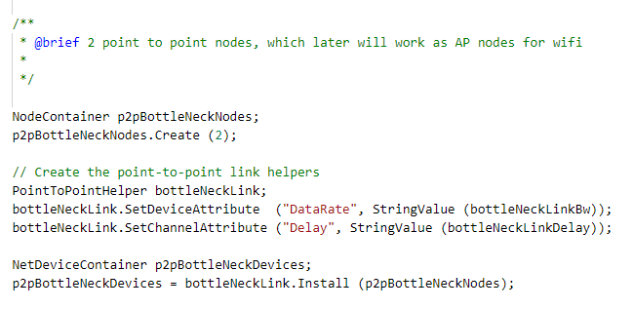
p2p connection

Slide 4

Building Topology

Slide 5
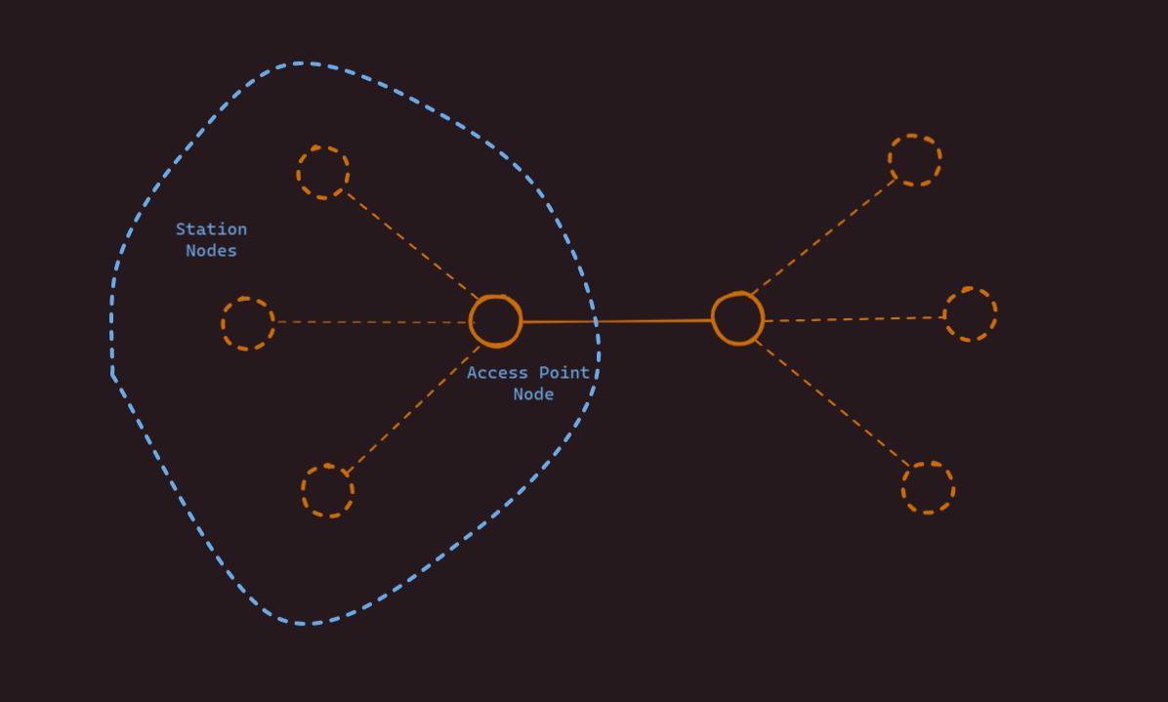
Building Topology

Slide 6
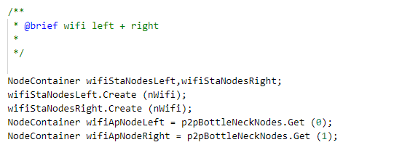
Wifi nodes

Slide 7
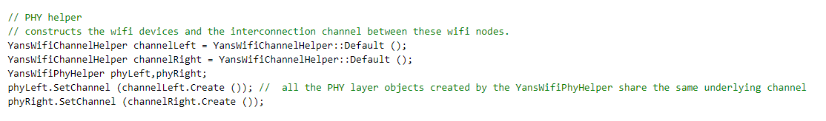
PHY Layer

Slide 8
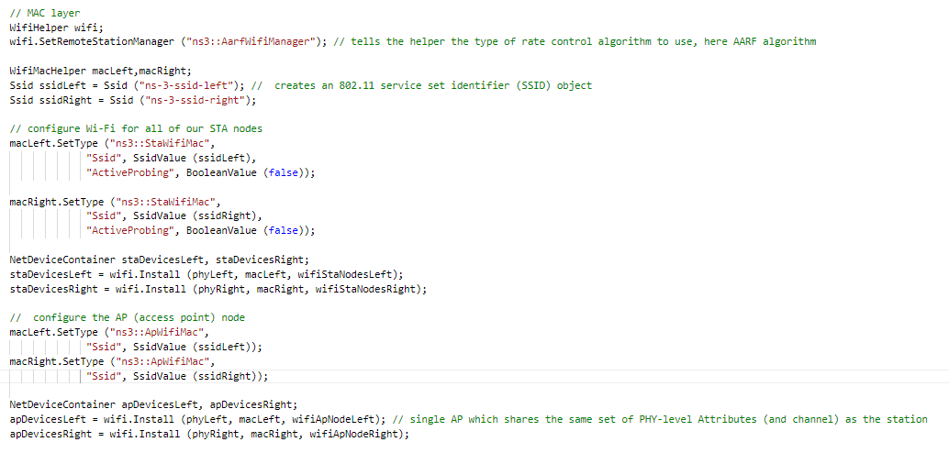
MAC Layer

Slide 9
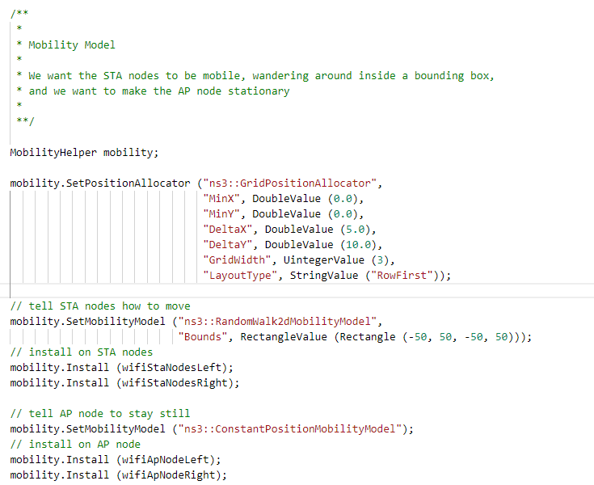
Mobility Model

Slide 10
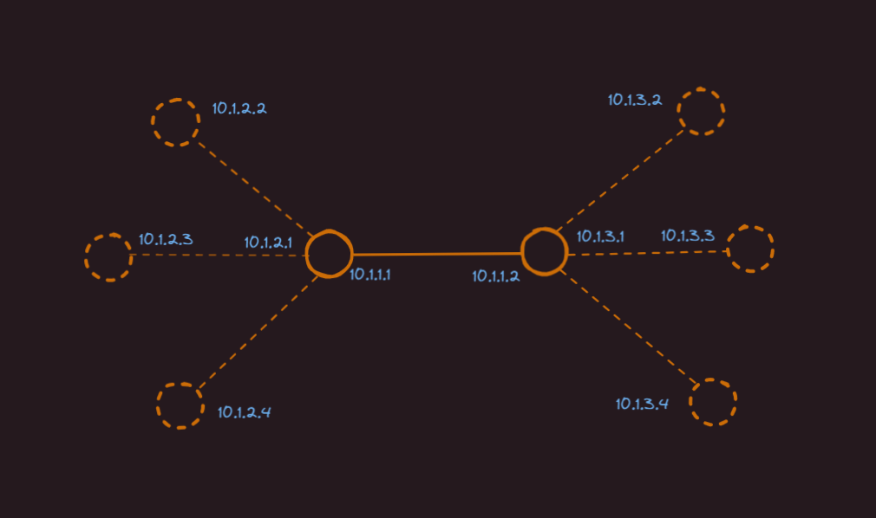
Assigning IP

Slide 11
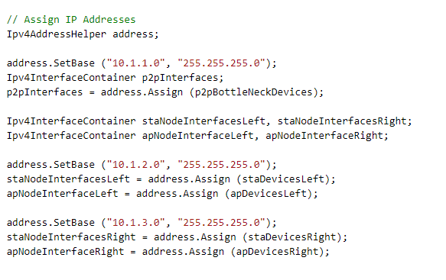
IP Address

Slide 12
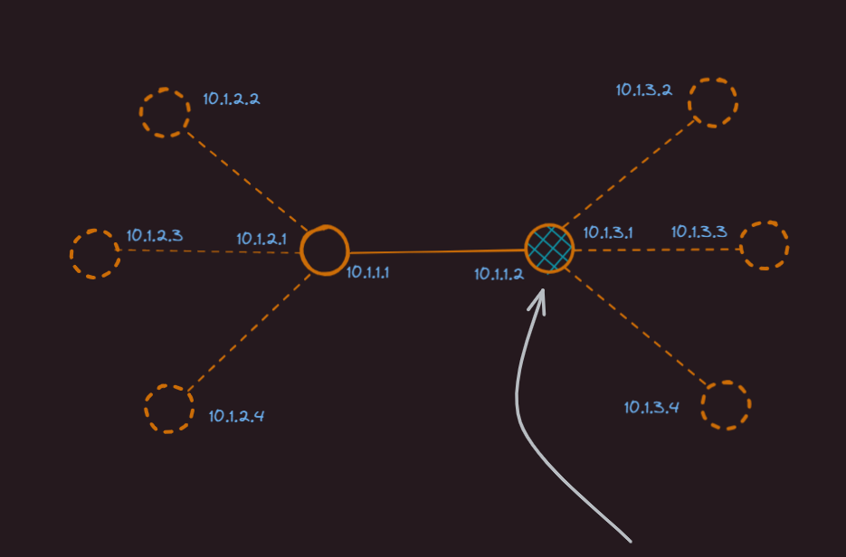
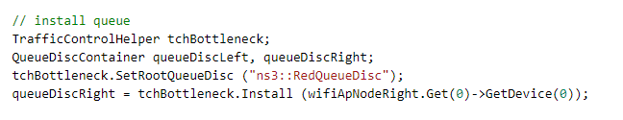
Using RED

Slide 13
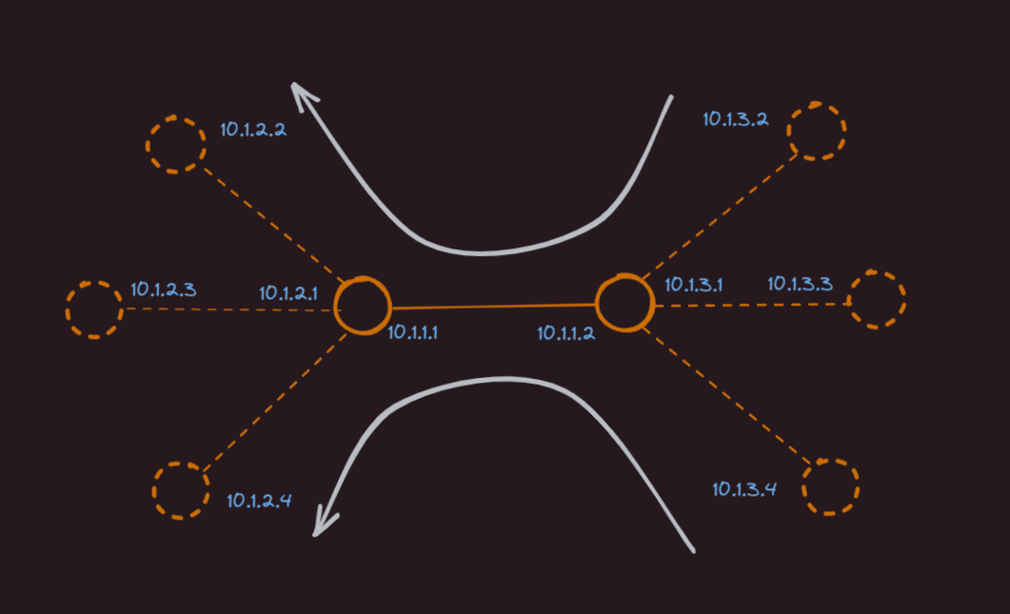
Flow

Slide 14
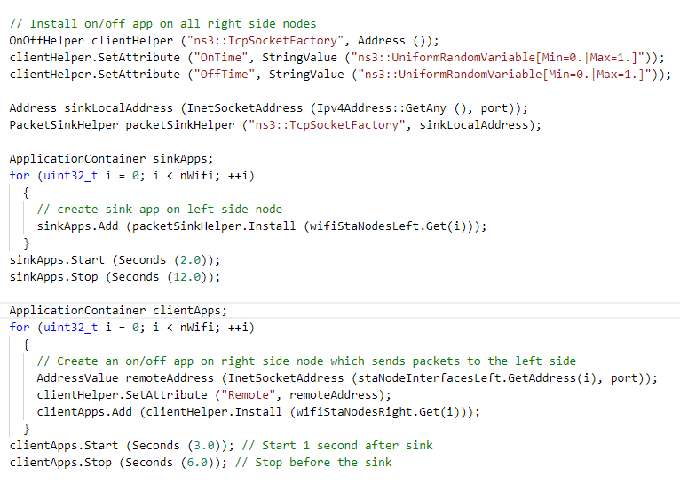
Flow

Slide 15
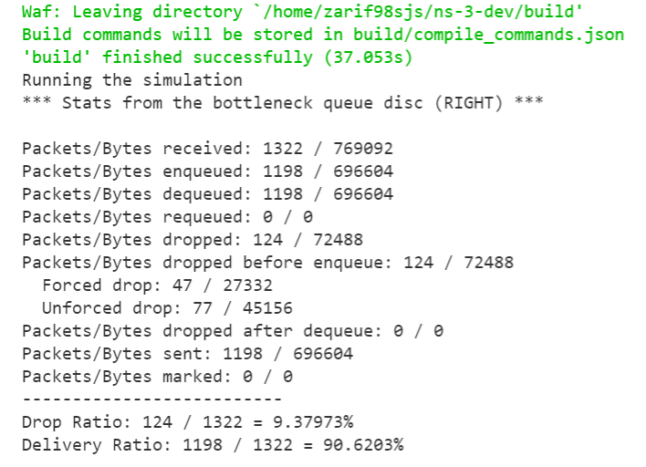
Performance Metrics

Slide 16
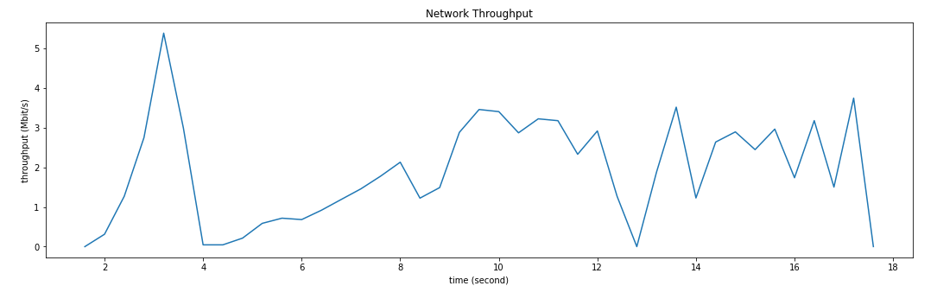
Throughput

Slide 17
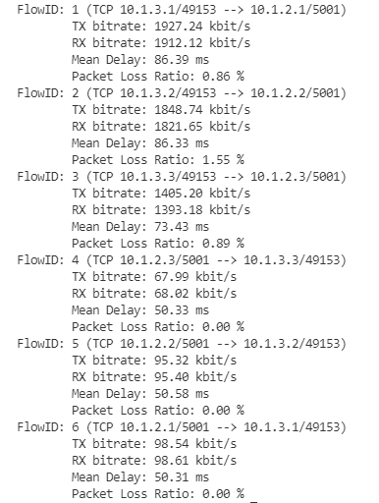
Flow Stats

Slide 18
THANK YOU

